Slide 1
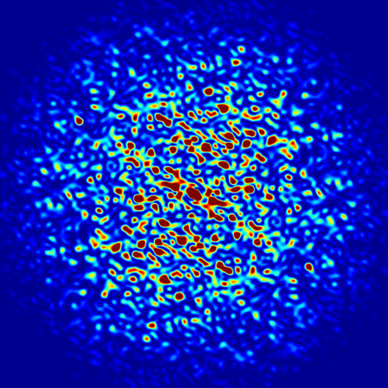
Introduction to OASYS-SRW
Luca Rebuffi (ANL)
Beamline Optics Design and Simulation Workshop
Hamburg, Germany
May 19-22, 2025
Notes:
Univ of Chicago Review, Aug. 30, 2010
1
Good morning, my name is Luca Rebuffi and I am staff member of the X-Ray Optics Group at the APS of the Argonne National Laboratory

Slide 2
Outline
Introduction
OASYS Automations
Propagation modes
Multi-Electron tools
Notes:
My presentation, after a brief introduction on WPPM method, will show you how this method has been ported into the graphical environment of the suite Orange, and then will show you a few example of the WONDER software in action

Slide 3
Introduction

Slide 4
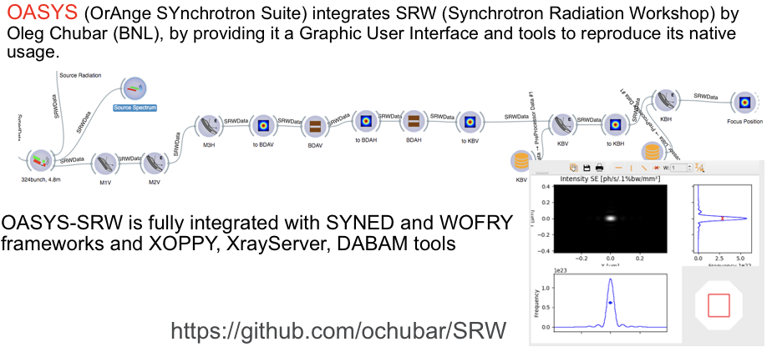
Introduction to OASYS-SRW
Notes:
Powder diffraction provides several information about a crystalline material: structural information like...

Slide 5
OASYS Automations

Slide 6
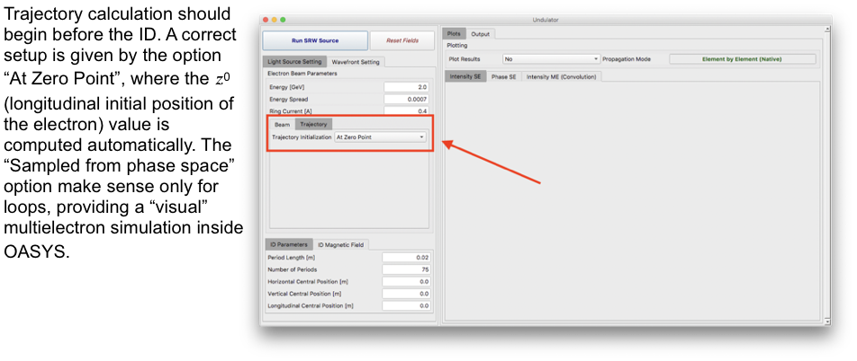
OASYS Automations: Sources
Notes:
Powder diffraction provides several information about a crystalline material: structural information like...

Slide 7
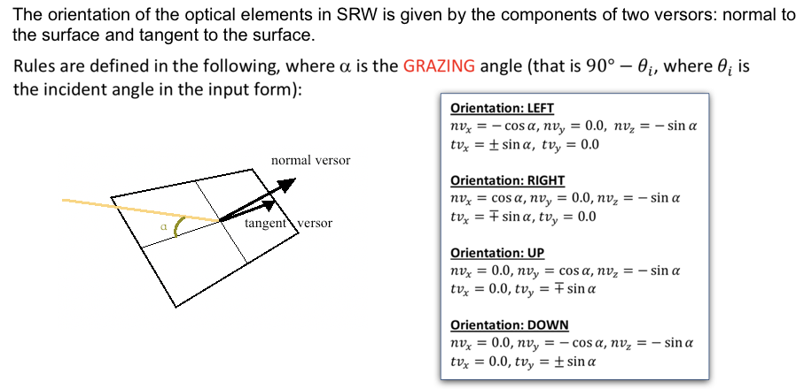
OASYS Automations: Optics Elements
Notes:
Powder diffraction provides several information about a crystalline material: structural information like...

Slide 8
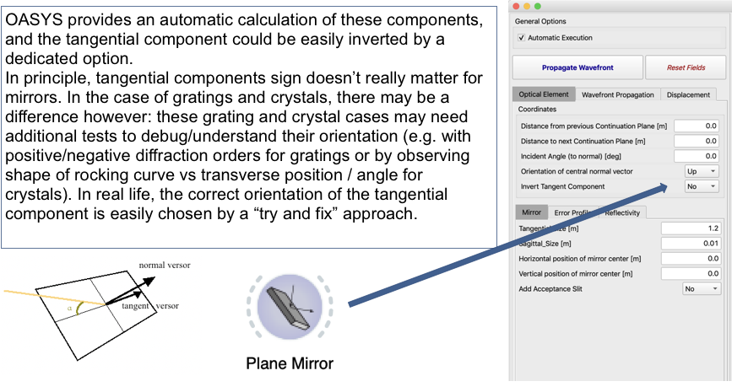
OASYS Automations: Optics Elements
Notes:
Powder diffraction provides several information about a crystalline material: structural information like...

Slide 9
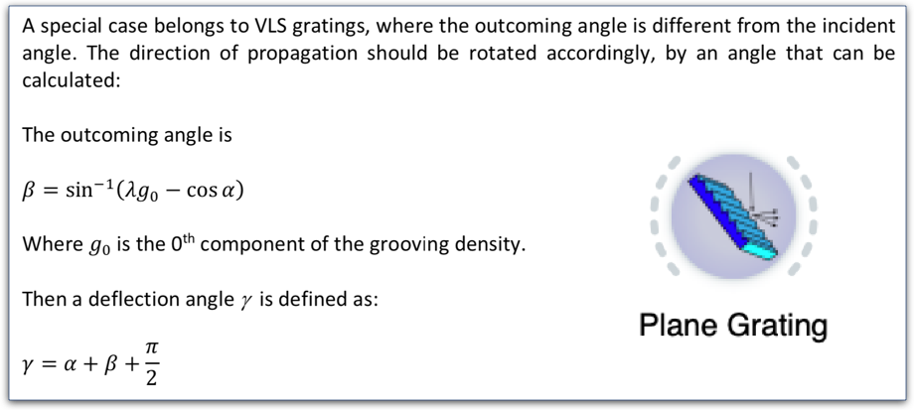
OASYS Automations: Gratings
Notes:
Powder diffraction provides several information about a crystalline material: structural information like...

Slide 10
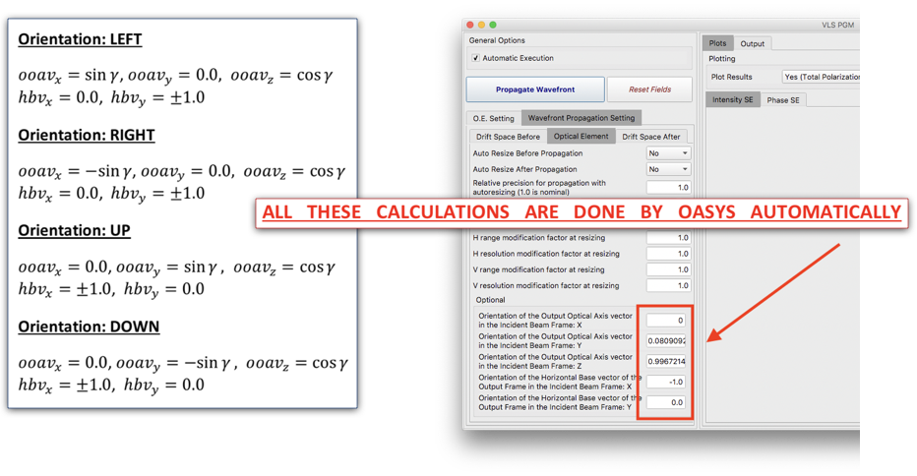
OASYS Automations: Gratings
Notes:
Powder diffraction provides several information about a crystalline material: structural information like...

Slide 11
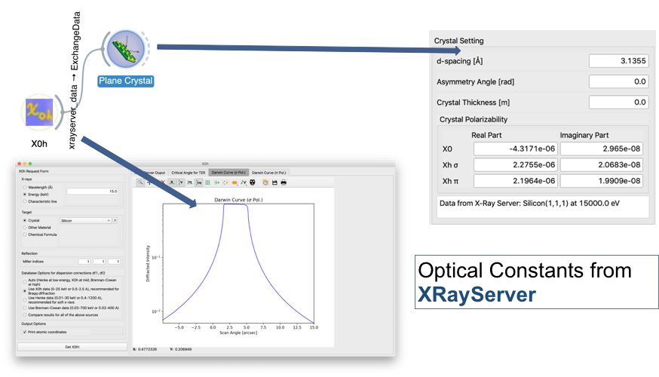
OASYS Automations: Crystals
Notes:
Powder diffraction provides several information about a crystalline material: structural information like...

Slide 12
Propagation modes

Slide 13
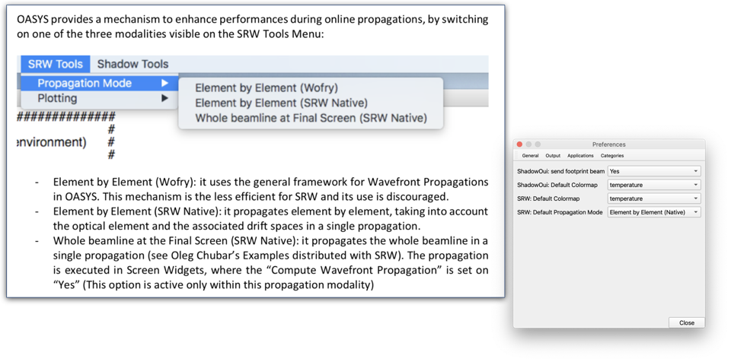
Propagation Modes
Notes:
Powder diffraction provides several information about a crystalline material: structural information like...

Slide 14
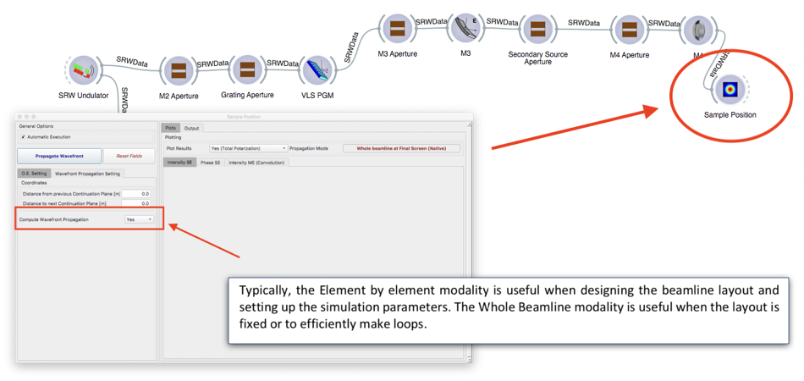
Propagation Modes
Notes:
Powder diffraction provides several information about a crystalline material: structural information like...

Slide 15
Multi-Electron Tools

Slide 16
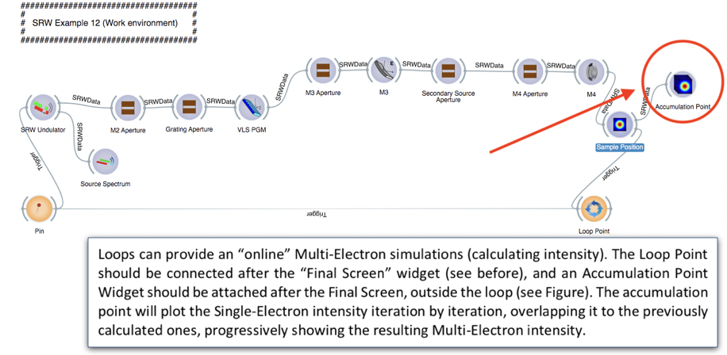
Multi-Electron Loops
Notes:
Powder diffraction provides several information about a crystalline material: structural information like...

Slide 17
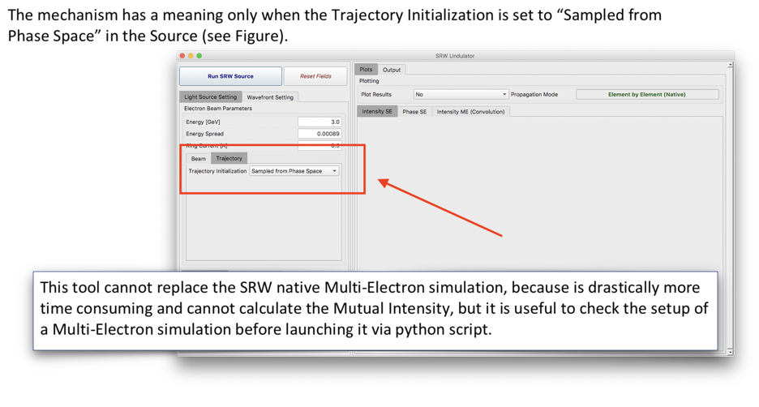
Multi-Electron Loops
Notes:
Powder diffraction provides several information about a crystalline material: structural information like...

Slide 18
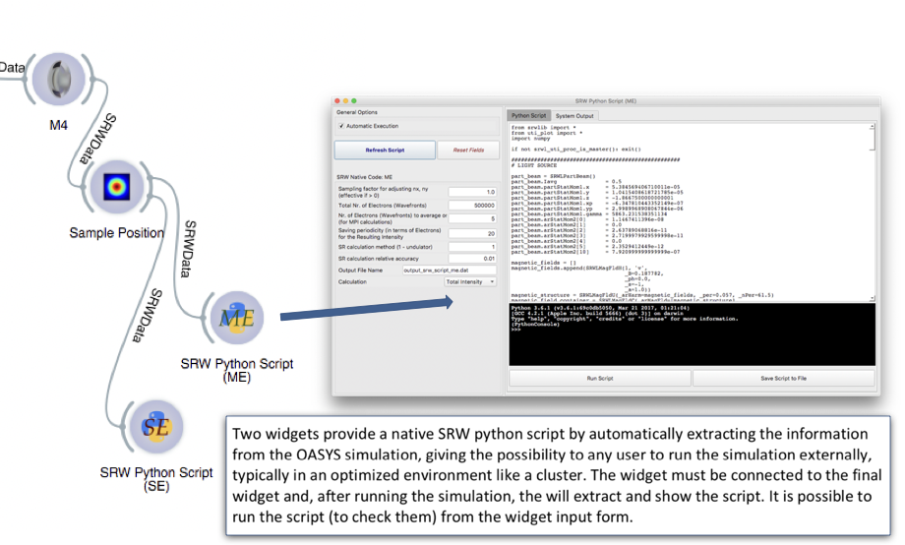
Native SRW Tools
Notes:
Powder diffraction provides several information about a crystalline material: structural information like...

Slide 19
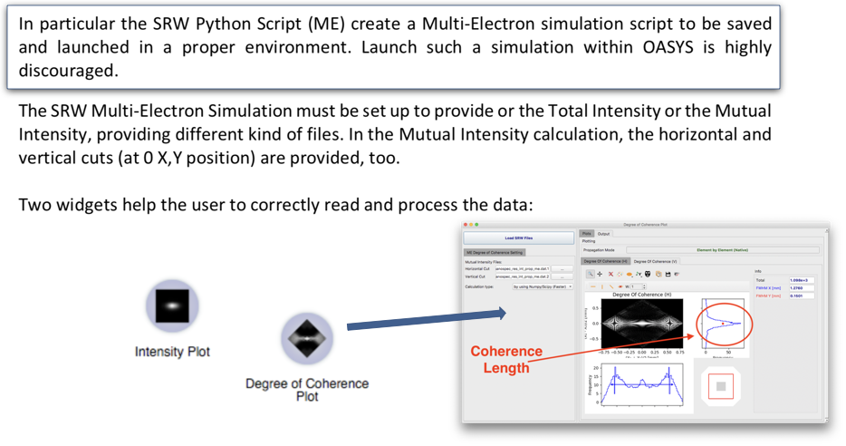
Native SRW Tools
Notes:
Powder diffraction provides several information about a crystalline material: structural information like...

Slide 20
Thank you!

